Slide 1
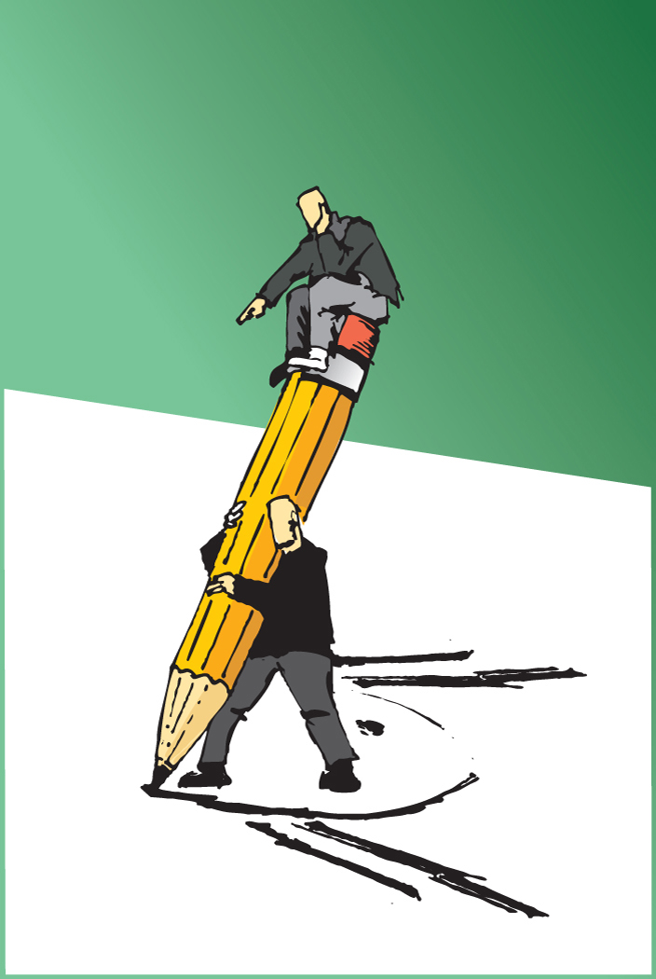
Lifting/Transfer; Injury Prevention
USE GAIT BELT on ALL transfers!
Wide Base Support
Position Body Close to and facing object to be moved
Bend from HIPS & Knees
Use Large Muscles; Gluteals, shoulders, upper arms, and thighs
Use both hands and arms to lift, move or carry objects
Carry Item close to body
Turn whole body when changing directions…NO TWISTING
Work with smooth Movements, no jerky or sudden moves
Do not lift heavy objects higher than chest level.

