Slide 1
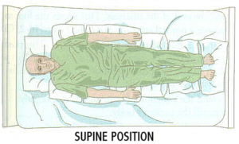
Supine Position
SUPINE POSITION 1. Start with the bed flat and the patient lying on the back. The patient's head should be about two to three inches from the head of the bed. 2. Place a pillow under the patient's head. It should extend about two inches below the patient's shoulders, with the head in the middle of the pillow.

