Slide 1
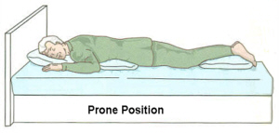
Prone Position
Start with the bed flat and the patient lying on the abdomen with head turned to either side, spine straight and legs extended. 1. Place a small pillow under the head so that it extends to the patient's shoulders and five to six inches beyond the face. 2. Place a small pillow under the abdomen. This relieves pressure on the back and reduces pressure against a female patient's breasts. An alternate method is to roll a towel and place it under the shoulders.

