Slide 1
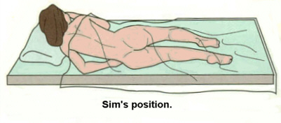
Sim’s Position
This position is a variation of lateral position with the patient on the left side, left leg extended and right leg flexed. This position is often used for rectal examination and treatments and enemas. 1. Place a pillow under the patient's head as for lateral position. 2. Start with the bed flat and the patient moved and turned onto the left side. 3. Extend the patient's left arm and position it behind the patient's back. 4. Flex the right arm and bring it forward. Support arm with a pillow.

